Slide 1
Principal Component Analysis
A review of its theoretical foundation and a practical use case
Anton Georgescu
Principal Product Architect, TEMS
December 2019

Slide 2
AGENDA
What is Principal Component Analysis
Mathematical foundation of PCA
How PCA works – a set of steps
PCA extraction
PCA terminology: Eigenvectors vs Eigenvalues
Practical use case with R packages
Demo
Other technologies that support PCA
Conclusion

Slide 3
What is Principal Component Analysis
Principal Component Analysis (PCA) is a dimensionality-reduction technique that is often used to transform a high-dimensional dataset into a smaller-dimensional subspace prior to running a machine learning algorithm on the data.
PCA is mathematically defined as an orthogonal linear transformation that transforms the data to a new coordinate system such that the greatest variance by some scalar projection of the data comes to lie on the first coordinate (called the first principal component), the second greatest variance on the second coordinate, and so on.
PCA, is a statistical procedure that is used prior to performing machine learning for a bunch of reasons:
Reducing the dimensionality of the dataset reduces the number of degrees of freedom of the hypothesis, which reduces the risk of overfitting.
Most algorithms will run significantly faster if they have fewer dimensions they need to look at.
Reducing the dimensionality via PCA can simplify the dataset, facilitating description, visualization, and insight.
Addresses the “curse of dimensionality” - a blanket term for an assortment of challenges presented by tasks in high-dimensional spaces;
Notes:
Hypothesis testing is an act in statistics whereby an analyst tests an assumption regarding a population parameter. The methodology employed by the analyst depends on the nature of the data used and the reason for the analysis. Hypothesis testing is used to infer the result of a hypothesis performed on sample data from a larger population.
Overfitting is a modeling error that occurs when a function is too closely fit to a limited set of data points.

Slide 4
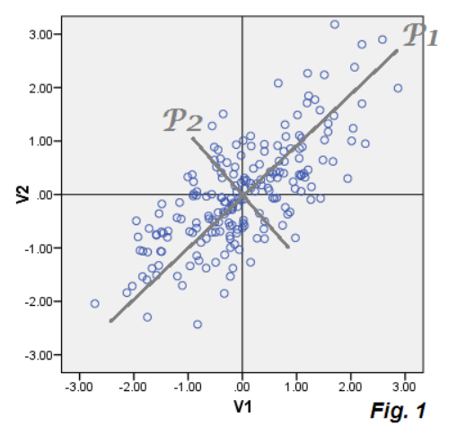
PCA in a Nutshell
In a nutshell, PCA is a transformation from a data “real rich space” into a “virtual simplified space.”
The new space can be read and analysed easier
The following slides are going to show us how we get from the real space to the virtual one.

Slide 5
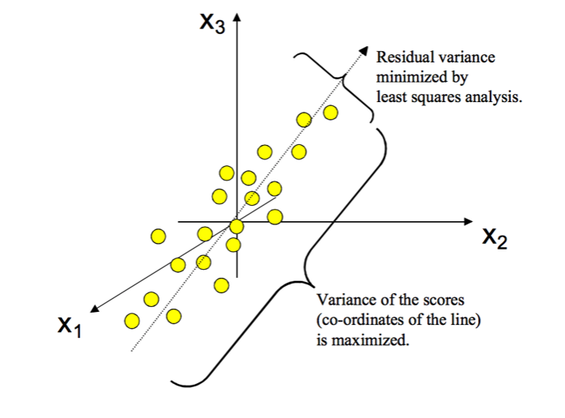
Mathematical Foundation of PCA
Statistically, PCA finds lines, planes and hyper-planes in the K-dimensional space that approximate the data as well as possible in the *least squares sense.
A K-dimensional space is where the location of a data point (observation) can be completely described with exactly k orthogonal axes.
A line or plane that is the least squares approximation of a set of data points makes the variance of the coordinates on the line or plane as large as possible.
PCA creates a visualization of data that minimizes residual **variance in the least squares sense and maximizes the variance of the projection coordinates.
-----------------------------------------------------------------------
* The least squares method is a statistical procedure to find the best fit for a set of data points by minimizing the sum of the offsets or residuals of points from the plotted curve.
** The variance (σ²) is a measure of how far each value in the data set is from the mean. ... Subtract the mean from each value in the data. This gives you a measure of the distance of each value from the mean.

Slide 6
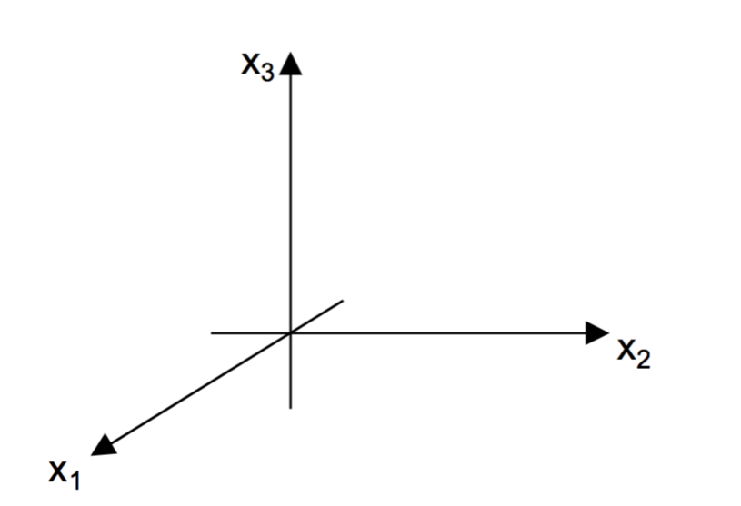
How PCA Works – Variable Space
Consider a matrix X with N rows (aka "observations") and K columns (aka "variables").
For this matrix we construct a variable space with as many dimensions as there are variables (see figure on the right).
Each variable represents one coordinate axis. For each variable, the length has been standardized according to a scaling criterion, normally by scaling to unit variance.

Slide 7
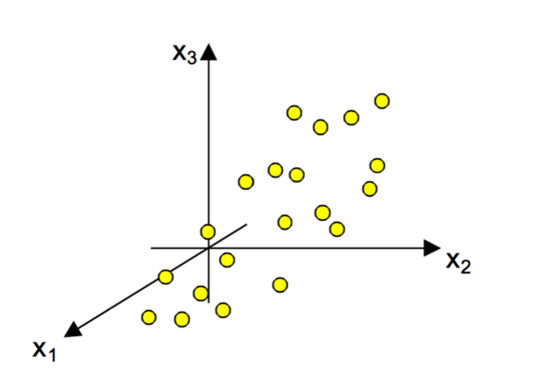
How PCA Works: Observations Space
In the next step, each observation (row) of the X-matrix is placed in the K-dimensional variable space. Consequently, the rows in the data table form a swarm of points in this space.

Slide 8
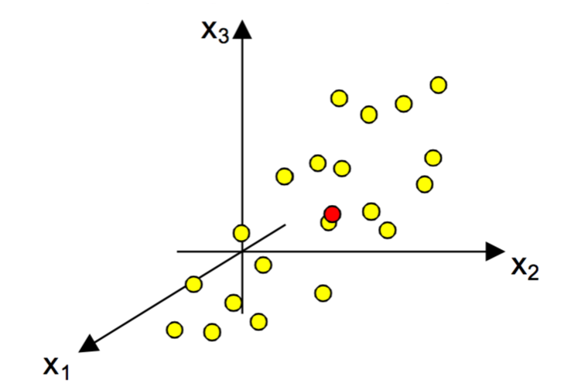
Hows PCA Works: Mean Centering
In this step we do *mean centering
Mean-centering involves the subtraction of the variable averages from the data. The vector of averages corresponds to a point in the K-space.
In the mean-centering procedure, you first compute the variable averages. This vector of averages is interpretable as a point (here in red) in space. The point is situated in the middle of the point swarm (at the center of gravity).
* In statistics in a general sense, to find the mean, add up the values in the data set (or population) and then divide by the number of values that you added.

Slide 9
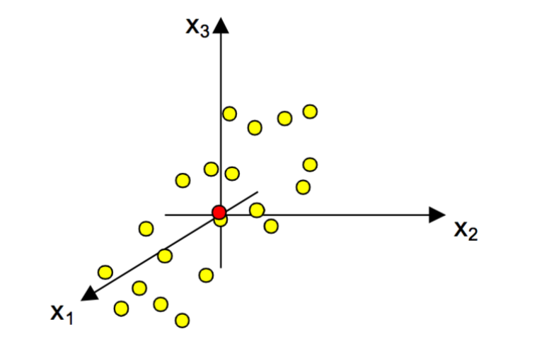
How Pca Works: Data Repositioning
The subtraction of the averages from the data corresponds to a re-positioning of the coordinate system, such that the average point now is the origin.
The mean-centering procedure corresponds to moving the origin of the coordinate system to coincide with the average point (here in red).

Slide 10
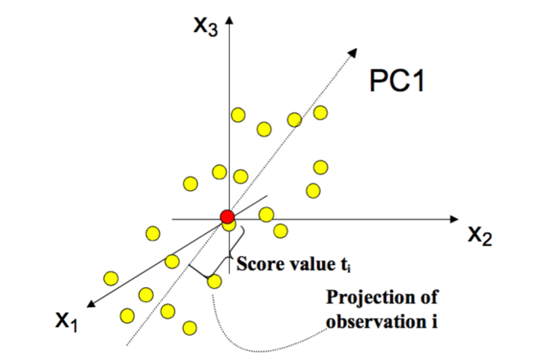
PCA Extraction: First Principal Component
After mean-centering and *scaling to unit variance, the data set is ready for computation of the first summary index, the first principal component (PC1).
This component is the line in the K-dimensional variable space that best approximates the data in the least squares sense.
This line goes through the average point. Each observation (yellow dot) may now be projected onto this line in order to get a coordinate value along the PC-line.
This new coordinate value is also known as the score.
* This function provides a data pretreatment approach called Autoscaling (also known as unit variance scaling). The data for each variable (metabolite) is mean centered and then divided by the standard deviation of the variable.

Slide 11
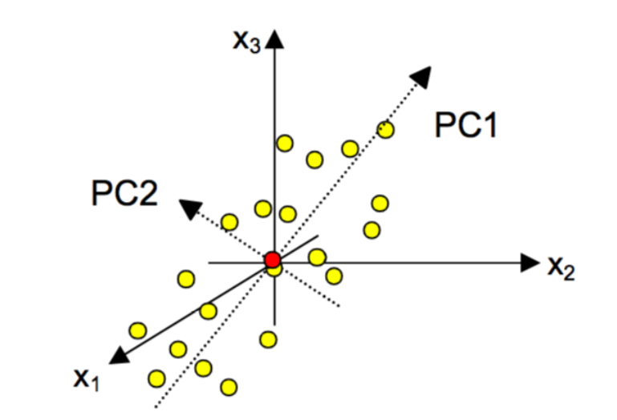
PCA Extraction: Second Principal Component
Usually, one summary index or principal component is insufficient to model the systematic variation of a data set. Thus, a second summary index – a second principal component (PC2) – is calculated.
The second PC is also represented by a line in the K-dimensional variable space, which is orthogonal to the first PC.
This line also passes through the average point, and improves the approximation of the X-data as much as possible.

Slide 12
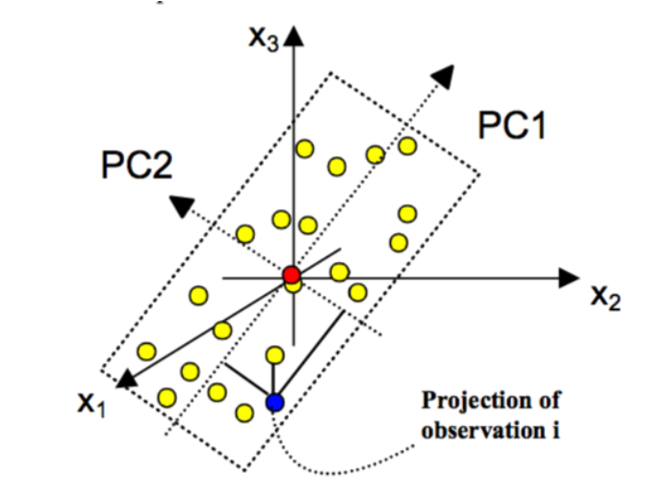
Two principal components define a model plane
When two principal components have been derived, they together define a place, a window into the K-dimensional variable space.
By projecting all the observations onto the low-dimensional sub-space and plotting the results, it is possible to visualize the structure of the investigated data set.
The coordinate values of the observations on this plane are called scores, and hence the plotting of such a projected configuration is known as a score plot.

Slide 13
How Many Principal Components you need to Extract
There is no strict rule-based answer to how many principal components we need to extract.
In general, the data will tend to follow the 80/20 rule. Most of the variance (interesting part of data) will be explained by a very small number of principal components. You might be able to explain 95% of the variance in your dataset using only 10% of the original number of attributes. However, this is entirely dependent on the dataset.
Often, a good rule of thumb is to identify the principal components that explain 80% of the variance in the data. By projecting all the observations onto the low-dimensional sub-space and plotting the results, it is possible to visualize the structure of the investigated data set.
You cannot have more principal components than the number of attributes in the original dataset.

Slide 14
Terminology: Eigenvectors
Mathematically, the principal components are the eigenvectors of the covariance matrix of the original dataset.
Covariance tell you how much two random variables vary together. It’s similar to variance, but where variance tells you how a single variable varies, covariance tells you how two variables vary together.
Because the covariance matrix is symmetric, the eigenvectors are orthogonal.
The principal components (eigenvectors) correspond to the direction (in the original n-dimensional space) with the greatest variance in the data.

Slide 15
Terminology: Eigenvalues
Each eigenvector has a corresponding eigenvalue. An eigenvalue is a scalar. Recall that an eigenvector corresponds to a direction. The corresponding eigenvalue is a number that indicates how much variance there is in the data along that eigenvector (or principal component).
In other words, a larger eigenvalue means that that principal component explains a large amount of the variance in the data.
A principal component with a very small eigenvalue does not do a good job of explaining the variance in the data.
In the extreme case, if a principal component had an eigenvalue of zero, then it would mean that it explained none of the variance in the data.
When PCA is used for dimensionality reduction, you will typically want to discard any principal components with zero or near-zero eigenvalues.

Slide 16
A PCA Use Case with R and factoMineR Package
The second part of this presentation will go through a practical case of PCA implementation
The subject of this use case is “Calculating the risk of student loan repayment delinquency with Principal Component Analysis”
The implementation is using two technologies:
.NET Framework’s WinForms for easy visualization of the PCA extraction procedure and its results
R language with a bunch of packages (most important FactoMinerR and factoextra) implementing the PCA methods

Slide 17
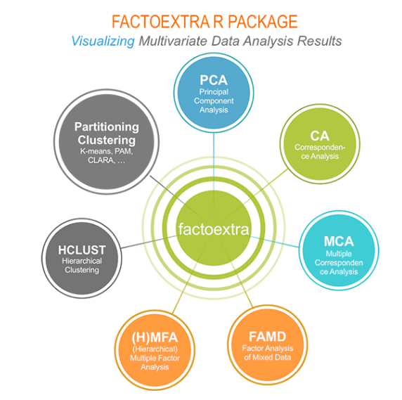
PCA Flavours with factoextra
factoextra is an R package making easy to extract and visualize the output of exploratory multivariate data analyses, including:
Principal Component Analysis (PCA), which is used to summarize the information contained in a continuous (i.e, quantitative) multivariate data by reducing the dimensionality of the data without loosing important information.
Correspondence Analysis (CA), which is an extension of the principal component analysis suited to analyse a large contingency table formed by two qualitative variables (or categorical data).
Multiple Correspondence Analysis (MCA), which is an adaptation of CA to a data table containing more than two categorical variables.
Multiple Factor Analysis (MFA) dedicated to datasets where variables are organized into groups (qualitative and/or quantitative variables).
Hierarchical Multiple Factor Analysis (HMFA): An extension of MFA in a situation where the data are organized into a hierarchical structure.
Factor Analysis of Mixed Data (FAMD), a particular case of the MFA, dedicated to analyze a data set containing both quantitative and qualitative variables.

Slide 18
More on FactoMiner R Package
FactoMineR is an R package dedicated to multivariate Exploratory Data Analysis. It is developed and maintained by François Husson, Julie Josse, Sébastien Lê, d'Agrocampus Rennes, and J. Mazet.
It performs classical principal component methods: Principal Components Analysis (PCA), Correspondence analysis (CA), Multiple Correspondence Analysis (MCA), clustering
The packages contains advanced methods that take into account a structure on the data (groups of variables, hierarchy on the variables, groups of individuals).
It allows to add supplementary informations such as supplementary individuals and/or variables.
It provides a geometrical point of view, a lot of graphical outputs, helps to interpret (automatic description of the dimensions, various indicators, ...).
It handles missing values with missMDA (see here).
It has a a GUI with a Shiny interface that draws interactive graphs with Factoshiny (see here)
It gives automatic interpretation of the results with FactoInvestigate (see here).

Slide 19
FactoMiner Fundamentals
When individuals are described by one set of variables, several methods are available depending on the types of variables considered (numerical or categorical variables):
When variables are numericals one can perform a PCA (Principal components analysis).
With a contingency table, one can perform a CA (Correspondence Analysis).
In statistics, a contingency table (also known as a cross tabulation or crosstab) is a type of table in a matrix format that displays the (multivariate) frequency distribution of the variables.
Contingency tables are heavily used in survey research, business intelligence, engineering and scientific research.
When individuals are described by a set of categorical variables one can perform a MCA (Multiple Correspondence Analysis).

Slide 20
FactoMiner – BIPLOT REPRESENTATION
Individuals study: similarity between individuals for all the variables (Euclidian distance) → partition between individuals
Variables study: are there linear relationships between variables? Visualization of the correlation matrix; ﬁnd some synthetic variables
Link between the two studies: characterization of the groups of individuals by the variables; particular individuals to better understand the links between variable
There are 3 views in relating both rows (individuals or observations) and columns (variables) to PCA:
Rows/cols coordinates (in the new orthogonal space)
Rows/cols squared correlation (a.k.a. goodness of fit) – The correlation (denoted r) measures the amount of linear association between two variables. r is always between -1 and 1 inclusive. The R-squared value, denoted by R ², is the square of the correlation.
Rows/cols contribution - refers to the length of vector that projects orthogonally on all eigenvectors. The bigger the length, the bigger the contribution (reflected in data inertia or variability.)

Slide 21
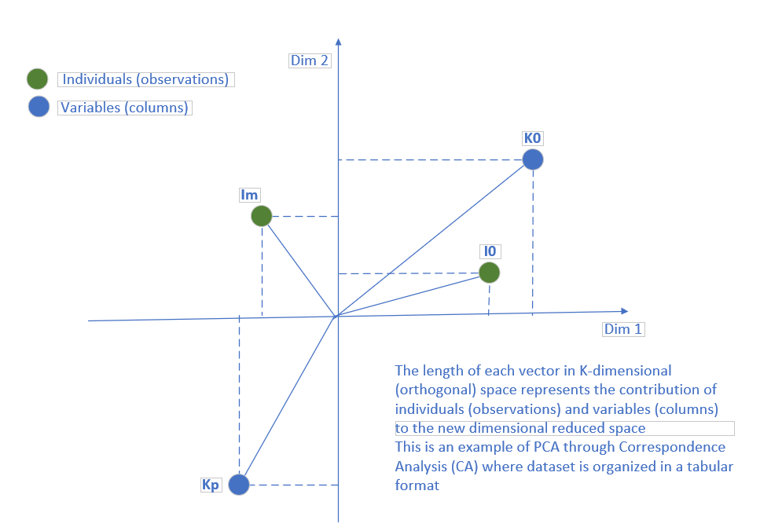
FactoMiner – BIPLOT REPRESENTATION
A Principal Components Analysis Biplot (or PCA Biplot for short) is a two-dimensional chart that represents the relationship between the rows and columns of a table.
Contingency tables are tools used by statisticians when they need to make sense of data that has more than one variable. Contingency tables are also called cross tabulation tables or cross tab. Contingency tables are displayed in matrix, or grid, form. The numbers displayed give the frequency of each data point

Slide 22
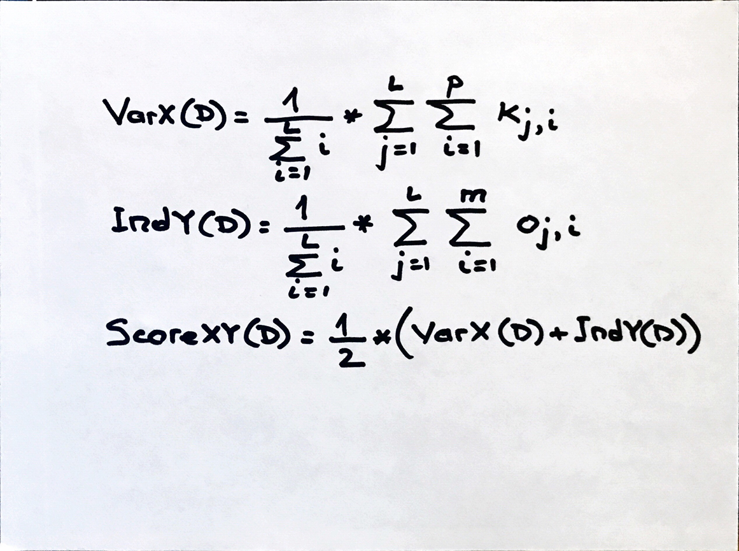
PCA Flavours with factoextra
The score calculated in the formula on the right side represents the total contributions of both individuals (observations) and variables (columns in a dataset organized in a 2-dimensional tabular format)
Since all the rows are observations linked to the phenomenon to be observed (true hypothesis) the score can be also equated to the “risk of occurrence” for the respective phenomenon
In the particular implementation we are bout to present this is the risk of having a loan going default (delinquency)

Slide 23
Demo
The code under https://github.com/antongeorgescu/risk-analysis-with-pca

Slide 24
Other Technologies that Support PCA
Python scikit-learn packages
Accord.NET Framework (NuGet)
.NET Extreme.Statistics.Multivariate classes
Machine Learning Studio (part of Azure cloud offering)
IBM Watson (part of IBM cloud offering)
Other R packages (eg pcaMethods)
etc.

Slide 25
Thank you
anton.georgescu@finastra.com

